Slide 1
Introduction to Java
Java Programming

Slide 2
Objectives
Become familiar with the Java language.
Explore Java language editions.
Become familiar with why Java language is important.
Explore Java as an independent platform
Become familiar with Java platform components (Java compiler, Java development kit (JDK), Java runtime environment (JRE), Java virtual machine (JVM) and Java just in time compiler(JIT).
Explore the relationship between JDK,JRE,JVM and JIT.
Explore how Java program is processed

Slide 3
Procedural Programming
Procedural programming: writing programs made of functions that perform specific tasks
Procedures typically operate on data items that are separate from the procedures
Data items commonly passed from one procedure to another
Focus: to create procedures that operate on the program’s data

Slide 4
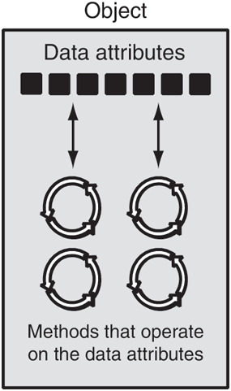
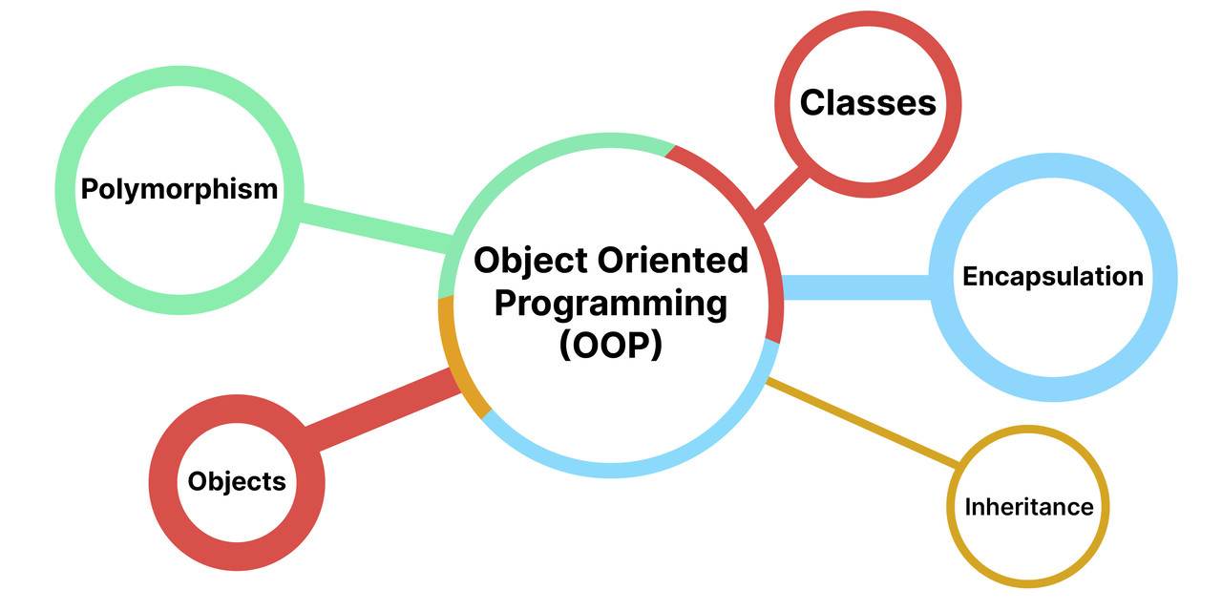
Object-Oriented Programming
Object-oriented programming: focused on creating objects
Object: entity that contains data and procedures
Data is known as data attributes and procedures are known as methods
Methods perform operations on the data attributes

Slide 5
What is Java?
Java is an object-oriented programming language.
1991 - Green Team started by Sun Microsystems.
Designed to be for general purposes such as developing desktop applications, web applications, mobile applications, games etc.
It also known as “Write Once Run Any Where” language (WORA).

Slide 6
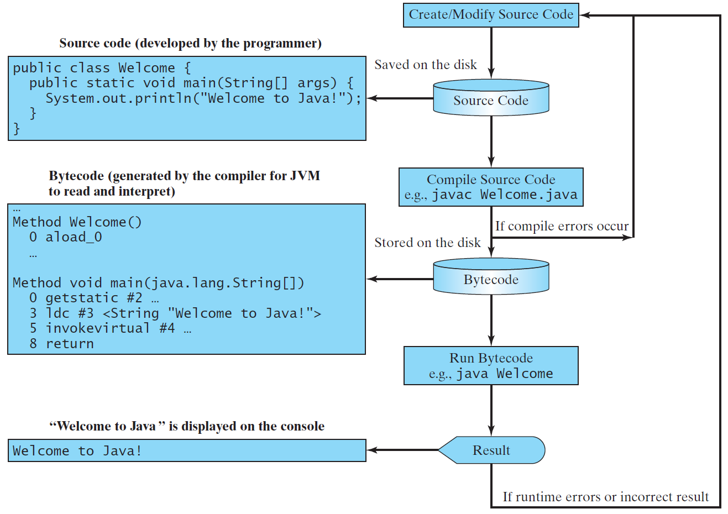
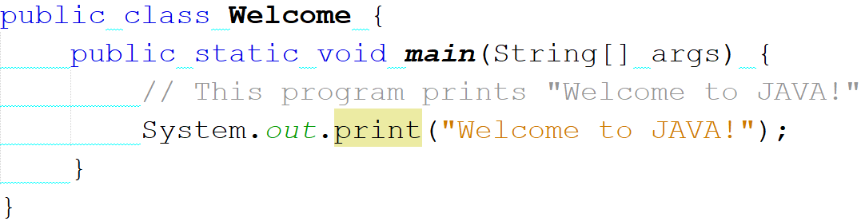
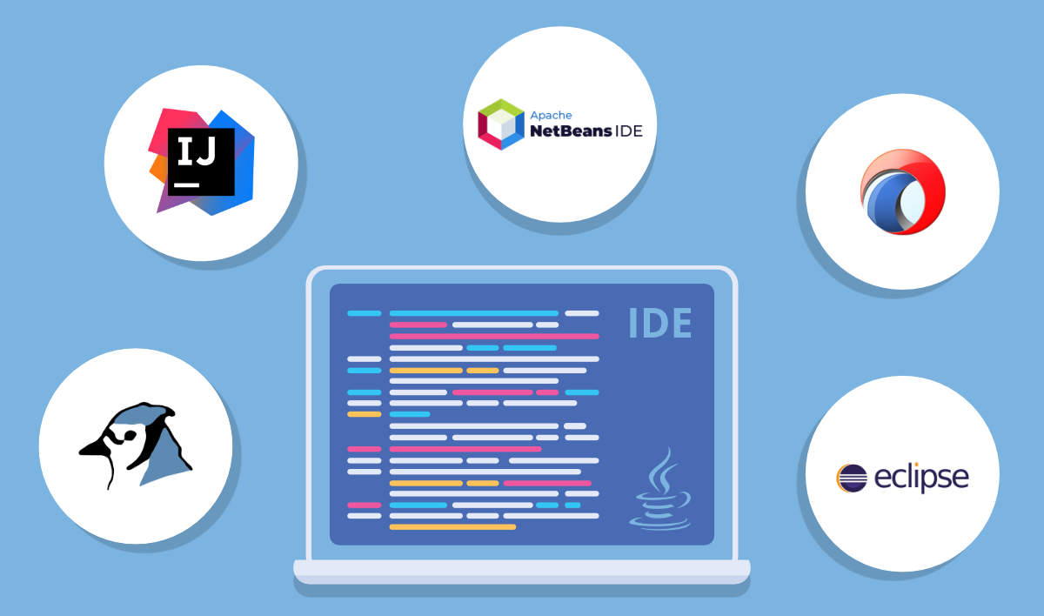
Java program components

Slide 7
Java Development Editions
Java Standard Edition (J2SE)
J2SE can be used to develop client-side standalone applications or applets.
Java Enterprise Edition (J2EE)
J2EE can be used to develop server-side applications such as Java servlets, Java ServerPages, and Java ServerFaces.
Java Micro Edition (J2ME).
J2ME can be used to develop applications for mobile devices such as cell phones.
This course uses J2SE.

Slide 8
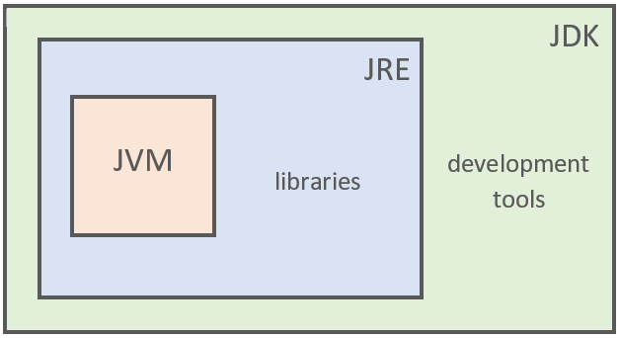
Components of Java Platform
There are three interrelated components for Java platform:
JDK (Java Development Kit)
JRE (Java Runtime Environment)
JVM (Java Virtual Machine)
JDK = JRE + Development Tools JRE = JVM + Library Classes

Slide 9
Java Development Kit (JDK)
The JDK is used to develop Java applications.
JDK internally contains JRE.
JDK contains
Compiler (javac)
Core class library
classes.zip
rt.jar

Slide 10
Java Development Kit (JDK)
JDK contains
Debugger (jdb)
Bytecode interpreter: The JVM (java)
Documentation generator (javadoc)
Java Archive utility (jar)
Others
Without JDK we cannot build any Java program.
Developers choose JDK by Java version and by package or edition.

Slide 11
Java Runtime Environment (JRE)
The JRE is the responsible unit to run the Java program.
Without JRE we cannot run Java program(JDK is used to build Java program, whereas JRE is used to run Java program).
JRE contains JVM.
JRE contains all the inbuilt packages and class library files(e.g. lang , io, util, etc).

Slide 12
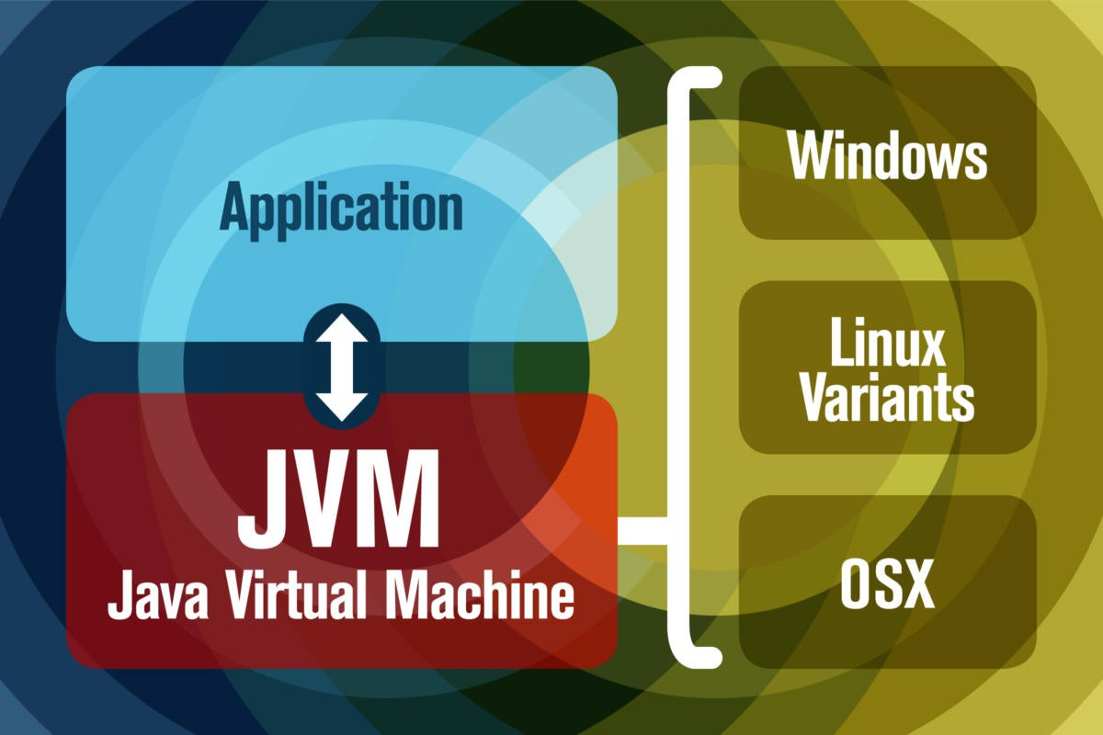
Java Virtual Machine (JVM)
JVM platform independent.
JVM is available for multiple operating systems, and programs created with the JRE will run on all of them.
JVM takes .class files and executes it by managing the memory.

Slide 13
Java Virtual Machine (JVM)
JVM contains JIT (Just In Time Compiler), which improves the performance of Java applications at run time
JVM loads, verifies, and executes the code and provides the runtime environment.
JVM plays a major role in Java memory management.

Slide 14
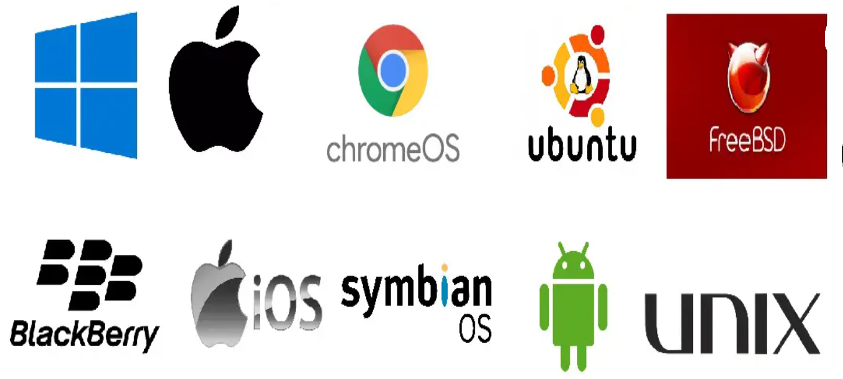
Java As Independent Computing Platform (Portability)
Portable means that a program may be written on one type of computer and then run on a wide variety of computers, with little or no modification.
Java byte code runs on the JVM and not on any particular CPU; therefore, compiled Java programs are highly portable.
JVMs exist on many platforms:

Slide 15
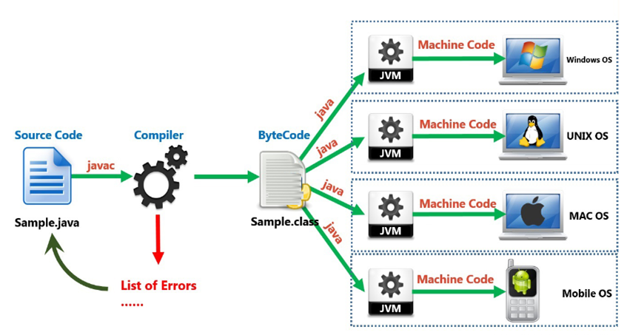
Java As Independent Computing Platform (Portability)

Slide 16
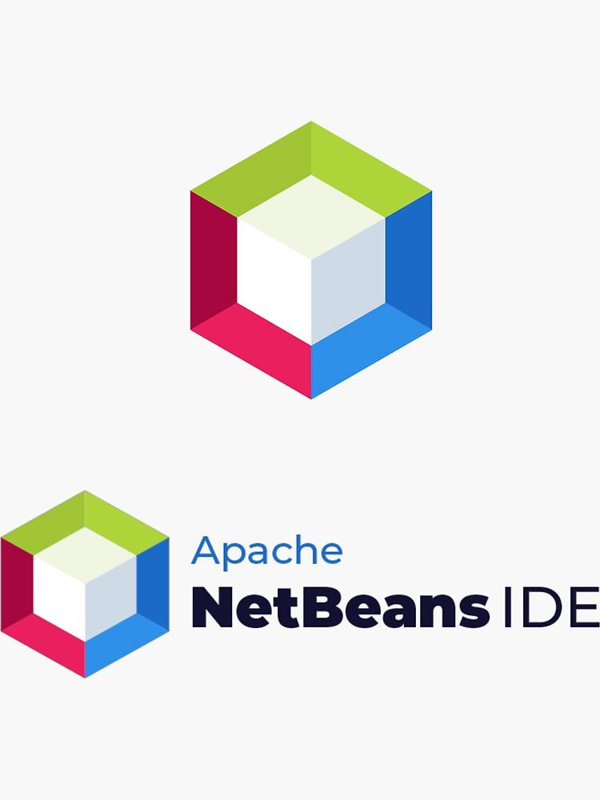
Java IDE
An integrated development environment (IDE) is a software application that helps programmers develop software code efficiently. It increases developer productivity by combining capabilities such as software editing, building, testing, and packaging in an easy-to-use application.
NetBeans
Eclipse
blueJ
intellJ
In this course we will use NetBeans IDE.

Slide 17
References
Introduction to Java Programming, Comprehensive Version, Student Value Edition, Daniel Liang, 12th Edition, Pearson 2019
lecture Notes: edugate.asu.edu.jo.
lecture Videos: YouTube channel.
How to install JDK & NetBeans IDE manual.

